Slide 1

Workload
Criticality

Slide 2
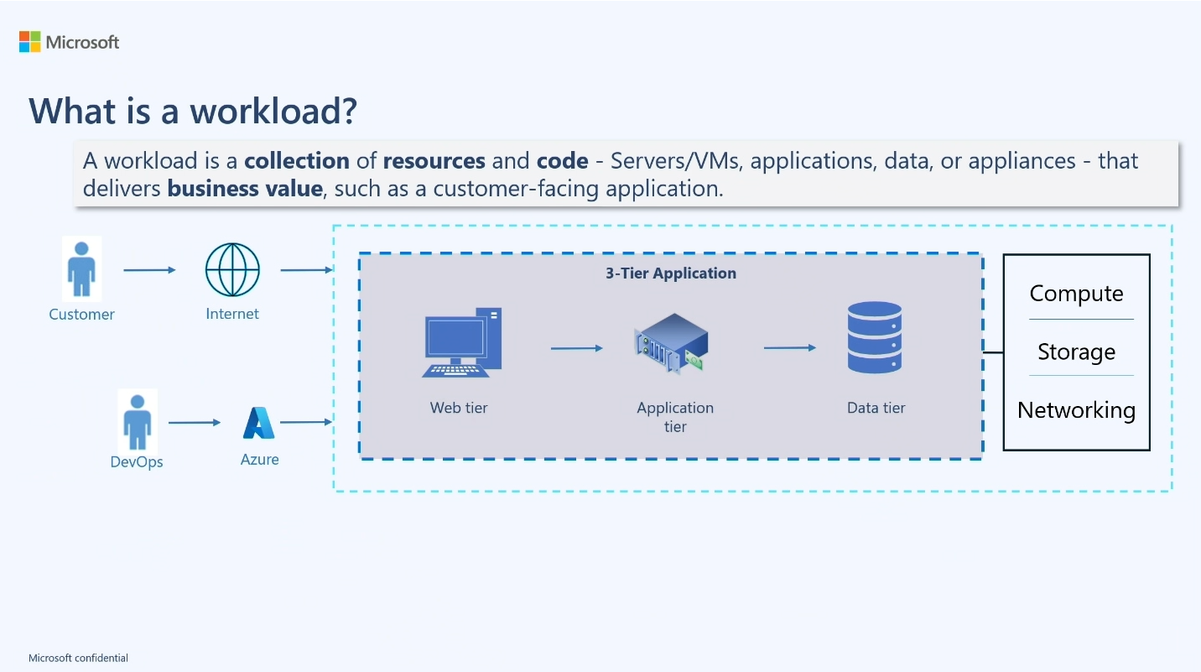
What is a workload?
A workload is a collection of resources and code – Services/VMs, applications, data, or appliances – that delivers business value, such as a customer-facing application.

Slide 3
Service Level Agreements
SLA
SLO

Slide 4
Service Level Agreements
SLA
Binding Agreement between provider and customer
SLO
Set Goals or target for service performance
SLI
A quantifiable measure of reliability

Slide 5
Regions
Region
Availability Zone 1
Datacenter(s)
Availability Zone 2
Datacenter(s)
Availability Zone 3
Datacenter(s)
Availability Zone 1
Availability Zone 2
Availability Zone 3

Slide 6
Disaster Event Scope
Impact Scope
Global
Resources: Service Providers, Authorities, IT Support
Availability (automated): Failover from the primary region (Australia East) to the secondary region (Australia Southeast) for all services delivering a critical business function. Deploy services to get the maximum Microsoft SLA.
Azure Availability Zone
Availability (automated): None
Availability (automated): Failover between three zones for all services delivering a critical business function
Azure Service Instance
Azure Geography
Availability: None
Azure Region
Continuity: Contingency Plan
Availability: None
Resources: Service Providers, Authorities, IT Support
Continuity: Contingency Plan
Continuity: Failover Plan, Recovery Plan
Resources: Service Providers, IT Support
Continuity: Failover Plan, Recovery Plan
Resources: Service Providers, IT Support
Continuity: Failover Plan, Recovery Plan
Data Integrity Issue
Availability: Not applicable
Resources: Service Providers, IT Support
Continuity: Recovery Plan
Recoverability: Redeploy, Restore
Recoverability (manual): Redeploy, Restore
Resources: IT Support, Vendor
Recoverability (manual): Restore
Recoverability (manual): Restore
Recoverability (manual): Restore
Recoverability (manual): Restore

